Slide 1

Hotel Booking Demand & Revenue Diagnostics
Data-Driven Insights Across 119,000+ Reservations to Mitigate Cancellations, Optimize ADR, and Enhance Guest Satisfaction

Slide 2

Executive Summary
Empirical analysis into hotel booking patterns, lead time sensitivity, market segment performance, and overbooking strategy to maximize RevPAR.

Slide 3

The Booking Demand Landscape
Substantial Revenue & Operational Friction
37.0%
Out of 119,390 hotel booking records analyzed across City and Resort properties, 44,224 reservations were cancelled prior to guest arrival.
Uncontrolled cancellation velocity distorts inventory forecasting, inflates re-distribution acquisition costs, and creates severe staffing inefficiencies during peak seasons.
Overall Booking Cancellation Rate

Slide 4

Dataset & Analytics Scope
119,390 Reservation Profiles: Multi-variate tracking spanning City Hotel (79,330) and Resort Hotel (40,060) properties.
Lead Time & Seasonality: Quantified booking windows ranging from 0 to 737 days ahead of arrival across 2015–2017.
Yield & Financial Indicators: Evaluated Average Daily Rate (ADR), deposit non-refundability, market segments, and special request counts.

Slide 5


City vs. Resort Property Dynamics
1. City Hotel (Business Focus)
2. Resort Hotel (Leisure Focus)
City properties suffer a severe 41.7% cancellation rate. Characterized by shorter stay durations (avg 3.0 nights), transient corporate travelers, and extreme sensitivity to OTA rate comparisons.
Resort properties maintain a lower 27.8% cancellation rate with longer stay durations (avg 4.3 nights), higher summer ADR spikes (€150–€250+), and higher guest commitment.

Slide 6
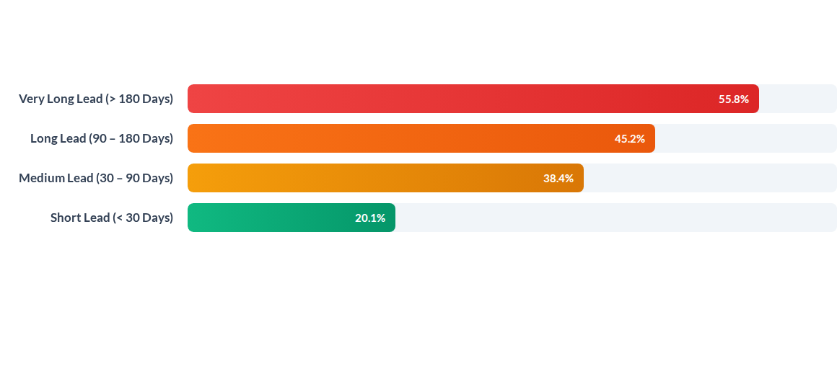
Cancellation Rate by Lead Time Window
Bookings made more than 6 months in advance are nearly 3x more likely to cancel than short-lead bookings. Long-lead inventory requires strict non-refundable terms or structured deposit schedules.

Slide 7






Core Predictors of Guest Commitment
Parking & Special Requests
Direct vs. OTA Distribution
Repeated Guest Loyalty
Guests requesting parking spaces show a near 0% cancellation rate. Adding 2+ special requests reduces cancellation probability by over 65%.
Direct bookings yield a low 15.4% cancellation rate, while Online Travel Agency (OTA) channels experience high cancellation rates exceeding 41%.
Repeat guests represent less than 3.2% of total bookings but exhibit a low 14.4% cancellation rate and higher incidental property spend.

Slide 8
Market Segment Performance Matrix
Market Segment | Avg Lead Time | Avg ADR (€) | Cancellation Rate | Strategic Value
Direct Bookings | 47 Days | €106.50 | 15.4%
Corporate Channel | 26 Days | €86.40 | 18.7%
Online TA (OTAs) | 84 Days | €116.30 | 41.1%
Offline TA / Tour Ops | 137 Days | €87.20 | 34.3%
Groups | 185 Days | €79.80 | 61.1%

Slide 9
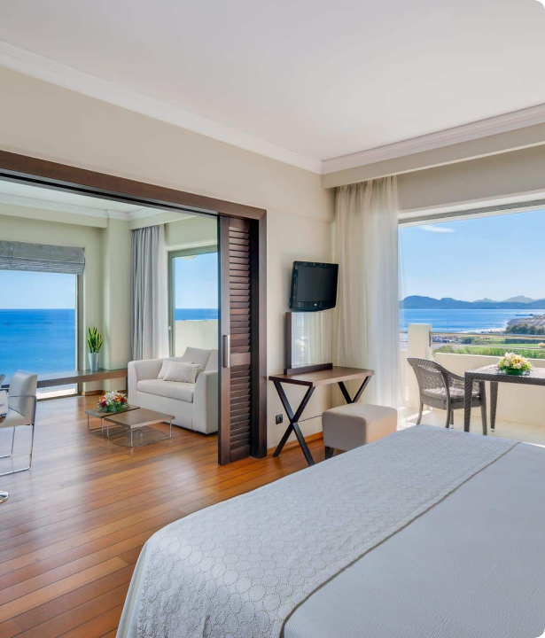
Revenue Leakage & Yield Management
The Overbooking Imperative
Unfilled room capacity resulting from late cancellations reduces potential RevPAR by up to 18% during high-demand months.
Implementing machine-learning driven dynamic overbooking models allows properties to re-sell cancelled room inventory seamlessly without risking walk-away penalties.

Slide 10
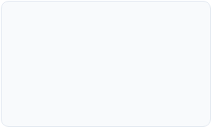
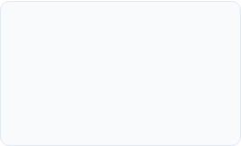

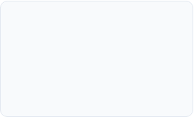
Strategic Optimization Roadmap
Q2 - Direct Booking Push
Q4 - Pre-Arrival Engagement
Launch best-rate guarantees, free parking, and breakfast for direct site bookings.
Automate personalized pre-arrival surveys encouraging special requests.
Q1 - Dynamic Overbooking
Q3 - Tiered Deposit Policy
Deploy ML models predicting daily cancellation probabilities by segment.
Enforce 20% non-refundable deposits for bookings with lead times > 90 days.

Slide 11

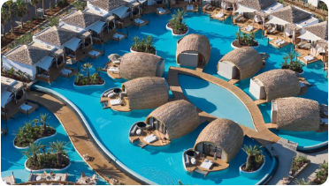

Core Action Pillars
Direct Channel Growth
Dynamic Rate & Restraint
Pre-Arrival Guest Lock-In
Migrate high-value guests from OTAs to direct web channels through exclusive loyalty perks and zero cancellation fees within 7 days.
Adjust lead-time pricing dynamically and introduce non-refundable discount tiers for long-horizon summer resort bookings.
Upsell dining packages, spa reservations, and parking pre-arrival to lock in guest commitment and drive non-room ancillary spend.

